Slide 1

MAILAM ENGINEERING COLLEGE
MAILAM
DEPARTMENT OF COMPUTER SCIENCE AND ENGINEERING
ANNA UNIVERSITY : CHENNAI 600 025
April 2023

Slide 2
ENHANCING VIDEO CROWD COUNTING WITH SPATIAL TEMPORAL GRAPH NETWORKS AND YOLO-BASED ARCHITECTURE FOR REAL-TIME APPLICATIONS
A PROJECT REPORT
Submitted by
BALAJI S 421619104014
HARIHARASUDHAN A 421619104025
JAYARAMAN A 421619104030
Project Mentor
S PRASANNA ASSO/PROF

Slide 3
ABSTRACT
Video crowd counting is a challenging task in computer vision due to the complexity of crowd dynamics and the large variation in crowd density. In this paper, we propose a novel approach for video crowd counting using a Spatial-Temporal Graph Network (STGN) and You Only Look Once (YOLO) Version 7.
The proposed STGN leverages the spatio-temporal dependencies among frames in a video to generate a graph representation of the crowd motion. The STGN architecture consists of three main components: a graph convolutional network (GCN) to model the spatial dependencies, a temporal convolutional network (TCN) to model the temporal dependencies, and a graph attention mechanism to capture the importance of different nodes in the graph. The STGN takes as input the feature maps generated by YOLO Version 7 and generates a crowd count for each frame in the video.

Slide 4




SOFTWARES USED
ANACONDA PROMPT INSTALL PYTHON JYPTER YOLO VERSION 7

Slide 5
SYSTEM REQUIREMENTS
HARDWARE REQUIREMENTS:
System : Pentium i3 Processor.
Hard Disk : 500 GB.
Monitor : 15’’ LED
Input Devices : Keyboard, Mouse
Ram : 4 GB
SOFTWARE REQUIREMENTS:
Operating system : Windows 7 &above.
Coding Language : Python
Web Framework : Flask

Slide 6
EXISTING SYSTEM
In the Existing system STGN, we adopt several PGMs and connect them in a dense manner, which can accelerate the convergence. Experiments are conducted on various datasets, such as large-scale datasets (FDST), small datasets (UCSD and Mall), and a vehicle counting dataset (TRANCOS).
In this paper, we capture pixel-wise and patch-wise relations in spatial-temporal domains, which learn deep hierarchical features and collaboratively work to effectively improve the representative ability of local regions.
This module introduces a spatial-aware channel-wise attention mechanism to fuse multi-scale features. Based on this module, we design a novel spatial-temporal graph network for video crowd counting.

Slide 7
PROPOSED SYSTEM
The proposed system for video crowd counting using a Spatial-Temporal Graph Network (STGN) and You Only Look Once (YOLO) Version 7 consists of two main components: STGN and YOLO Version 7.
The STGN component takes as input a sequence of video frames and generates a graph representation of the crowd motion. The STGN architecture consists of a graph convolutional network (GCN), a temporal convolutional network (TCN), and a graph attention mechanism. The GCN models the spatial dependencies among the nodes in the graph, while the TCN models the temporal dependencies among the frames in the video. The graph attention mechanism is used to capture the importance of different nodes in the graph. The STGN takes the feature maps generated by YOLO Version 7 as input and generates a crowd count for each frame in the video.
The YOLO Version 7 component is used to detect and track individuals in the video frames. YOLO Version 7 is a state-of-the-art object detection and tracking model that is able to achieve high accuracy and real-time performance. The YOLO Version 7 component generates feature maps for each frame in the video, which are then fed into the STGN component for crowd counting.

Slide 8
MODULES
The Spatial-Temporal Graph Network (STGN) for Video Crowd Counting using YOLO Version 7 is a deep learning architecture that consists of several modules. Here's a brief description of each module:
YOLOv7 object detection: The first module is the YOLOv7 object detection algorithm, which is used to detect people in the video frames. YOLOv7 uses a single neural network to perform object detection and classification, making it fast and efficient.

Slide 9
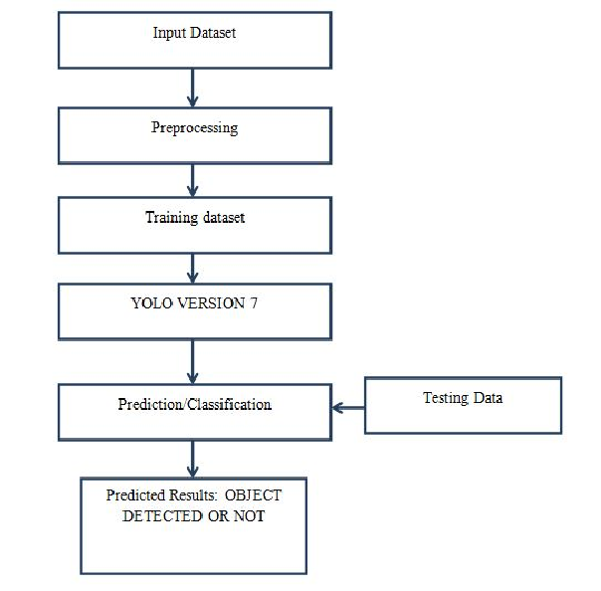
FLOW DIAGRAM

Slide 10
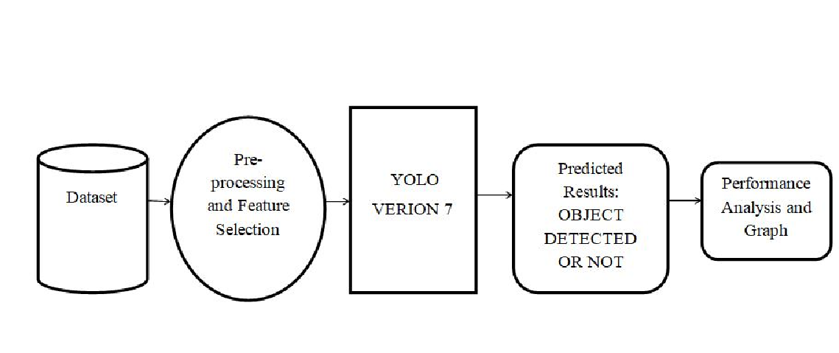
ARCHITECTURE DIAGRAM

Slide 11
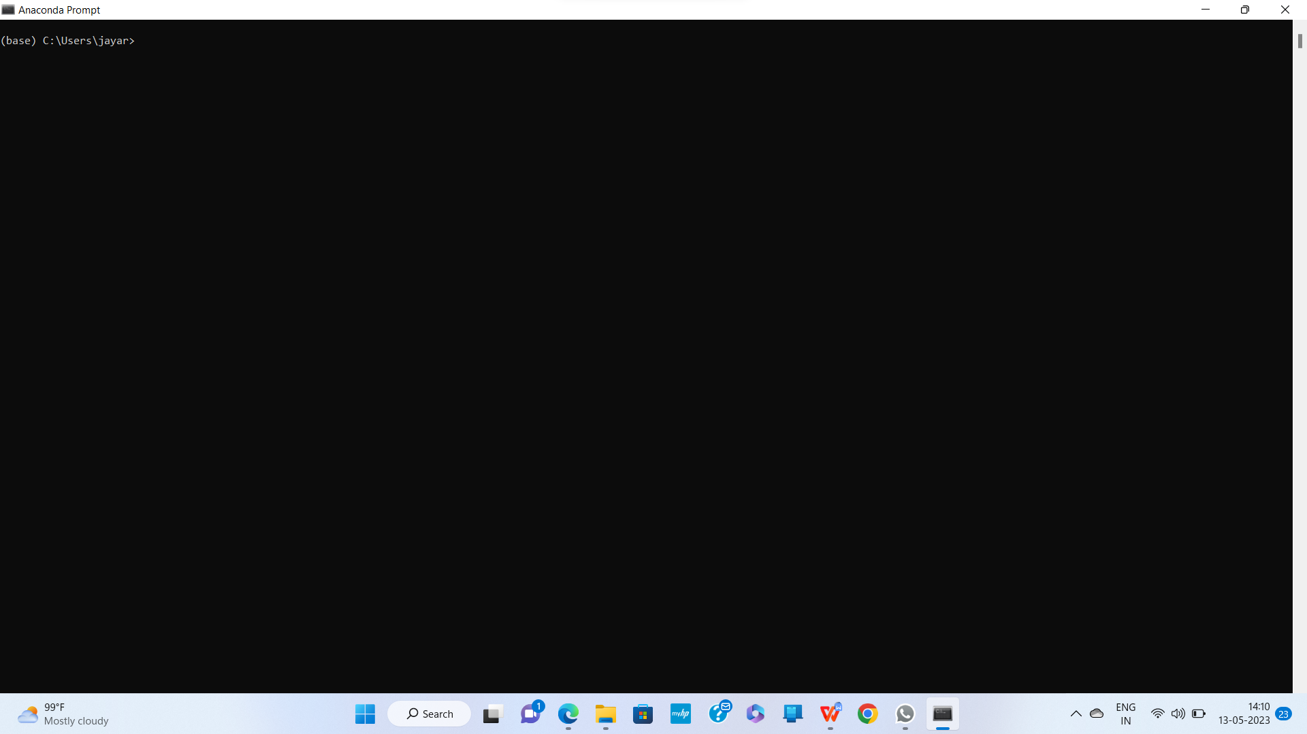
STEPS TO RUN THE PROJECT IN YOUR MACHINE :
Download and Install
Download and Install the Anaconda Software.
Open
Open the command prompt type 'D:' then prompt is ready to access our project to run.

Slide 12
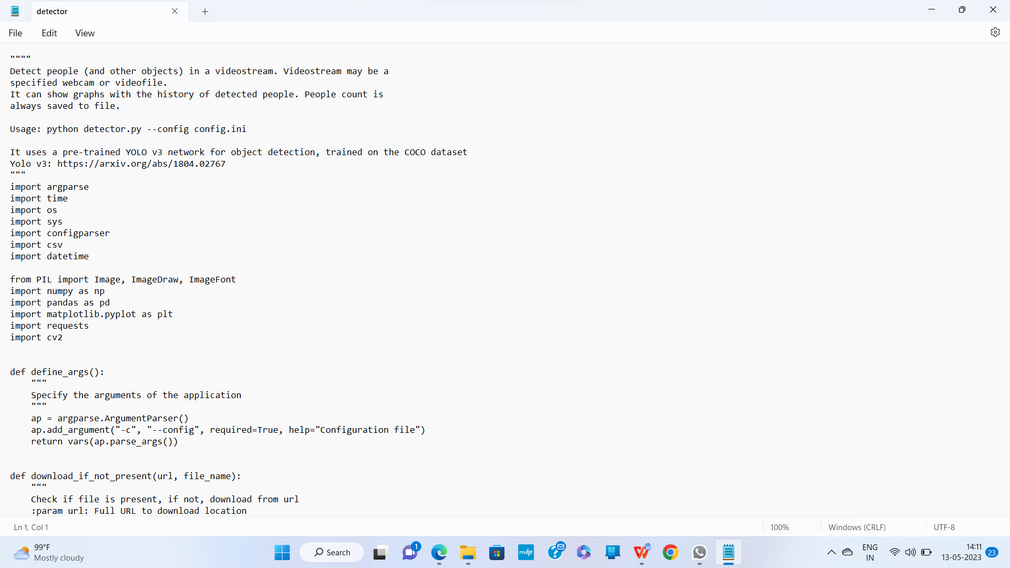
DEDECTED CODE SCREENSHOT

Slide 13
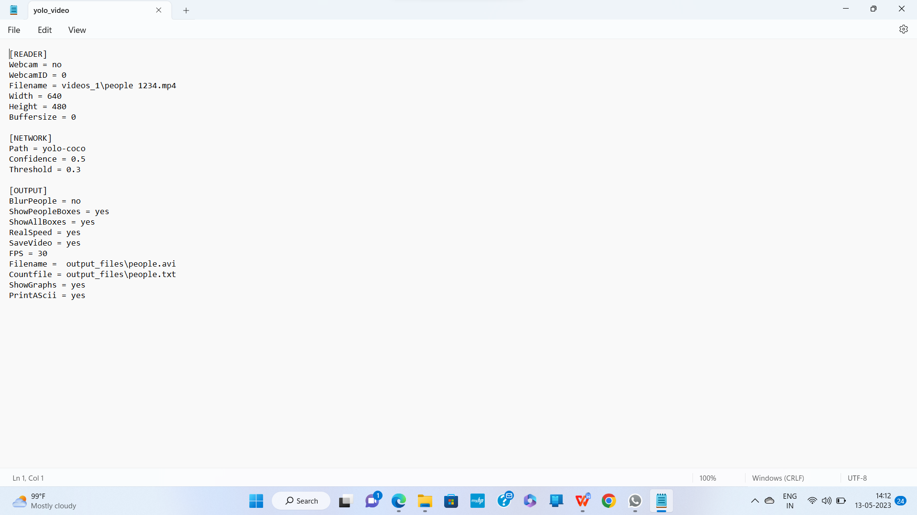
It will collect the inputs given by the yolo and transfer it to the detection software through the anaconda prompt.

Slide 14
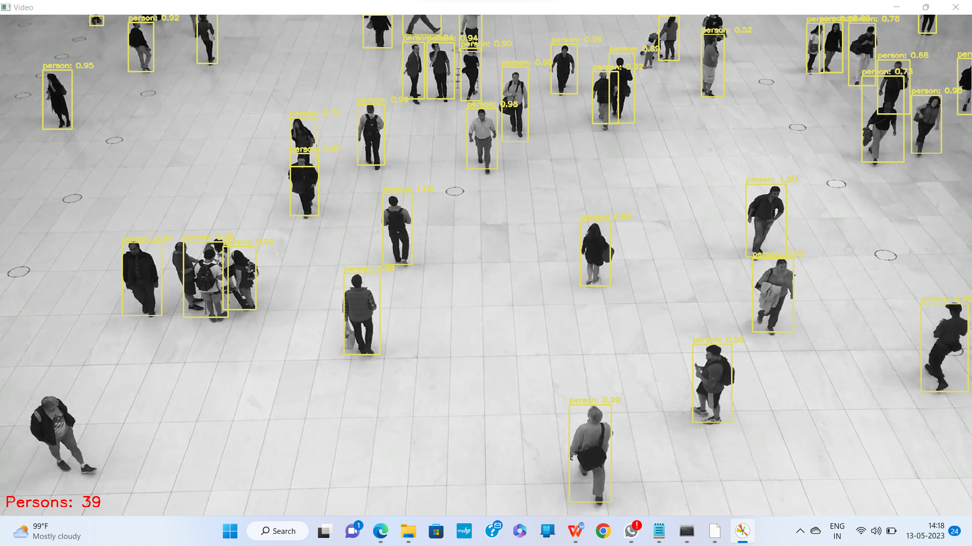
VIDEO INPUT SCREENSHOT

Slide 15
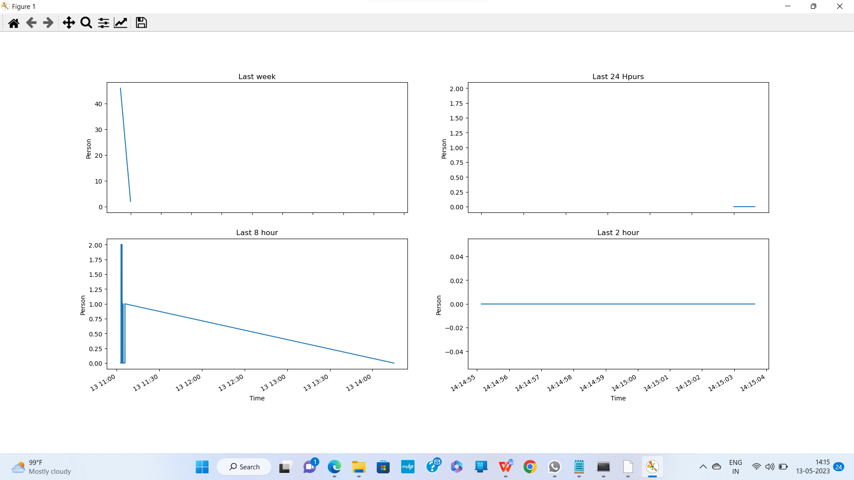
PREDICTION GRAPH

Slide 16
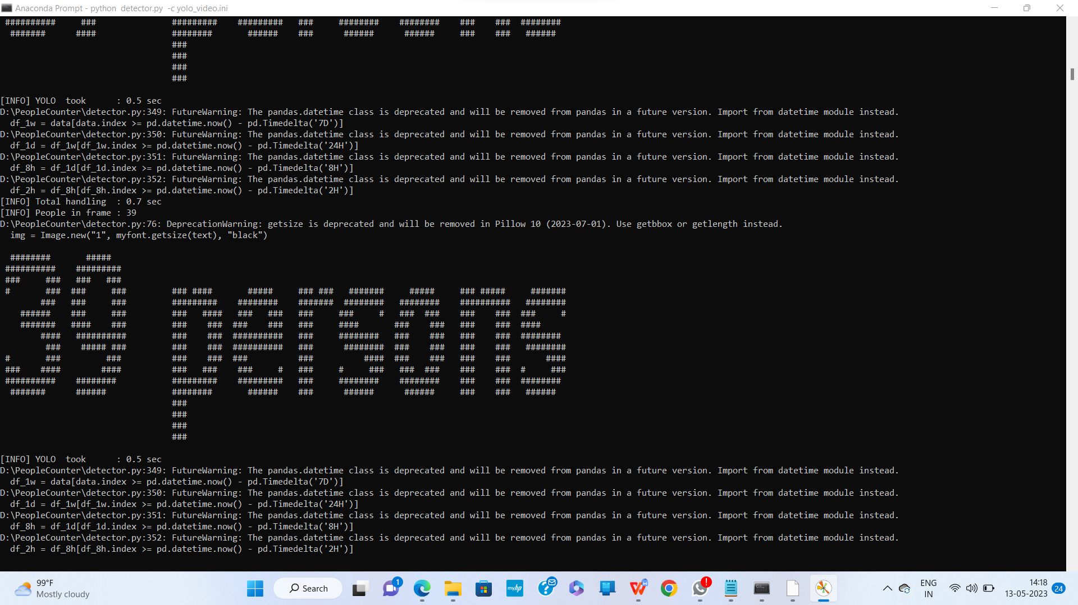
OUTPUT SCREENSHOT

Slide 17
ADVANTAGES
Accurate crowd counting: STGN with YOLO Version 7 has been shown to achieve state-of-the-art performance in video crowd counting benchmarks, with higher accuracy compared to other methods.
Spatial-temporal modeling: By modeling the spatial and temporal interactions between people in a video sequence, STGN can capture the complex dynamics of crowd behavior, which can be useful for tasks such as anomaly detection or predicting crowd flow.
Scalability: STGN is scalable to different video resolutions and can handle large crowds with high efficiency.

Slide 18
DISADVANTAGES
Requires annotated data: Like all deep learning approaches, STGN requires annotated training data, which can be time-consuming and expensive to obtain, especially for large-scale datasets.
Sensitivity to hyperparameters: The performance of STGN can be highly sensitive to hyperparameters such as the number of graph nodes or the size of the receptive field, which can make it difficult to achieve optimal results.
Limited generalizability: STGN has been shown to perform well on video crowd counting tasks, but its generalizability to other domains or tasks may be limited.

Slide 19

CONCLUSION
The Spatial-Temporal Graph Network (STGN) is a promising approach for video crowd counting that utilizes both spatial and temporal information in a graph-based framework. This method builds a graph representation of the video frames, where each node corresponds to a patch in the image and edges connect neighboring patches. The graph is then fed into a deep neural network that predicts the crowd count for each patch, which is then aggregated to obtain the final crowd count for the entire image.
The STGN method has shown to achieve state-of-the-art results on several crowd counting datasets, outperforming previous methods that only utilize spatial or temporal information. Furthermore, the graph-based framework of STGN allows for flexibility in modeling spatial and temporal relationships between image patches, making it a suitable approach for various video crowd counting scenarios.

Slide 20

THANK YOU !!

